Slide 1
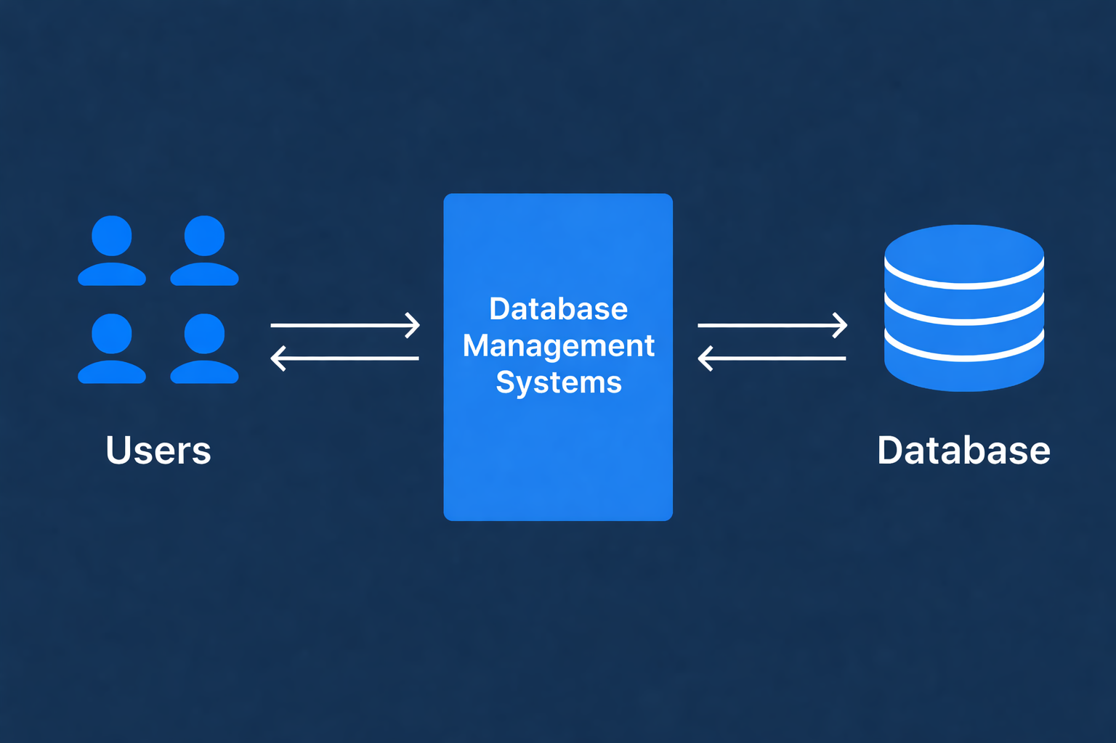
Essentials of Database Management System (DBMS)
“A database is the organized memory of an organization.”

Slide 2

Traditional File System
A file-based system is a method of storing and managing data in individual files.
These files are organized in directories or folders on a computer’s storage device.
Data Redundancy Data Inconsistency Poor Data Security Difficult Data Access
⚠ The Fatal Weakness of File System
“These weaknesses make file systems inefficient, leading to the need for DBMS.”

Slide 3
What is DBMS?
A Database Management System (DBMS) is software used to manage data from a database.
It acts as an interface between the database and end users or applications, ensuring data is consistently organized , easily accessible, and secure.
FEATURES
FILE SYSTEM
DBMS
Redundancy
Consistency
Security
Data Access
Integrity
High
Poor
Weak
Difficult
Not Maintained
Low
High
Strong
Easy
Maintained
“DBMS overcomes limitations of traditional file systems.”

Slide 4
Features Relational (SQL) NoSQL (Non-Relational)
Data Structure
Structured (Table-based)
Unstructured (Document, Key-Value)
Schema
Rigid (Defined upfront)
Flexible (Dynamic)
Query Language
Varies (UnQL, JSON, API-based)
SQL (Standardized)
Scaling
Vertical (Add power to server)
Horizontal (Add more servers)
Relationships
Supported via JOINS
Not heavily supported (often denormalized)
Transactions
ACID (Strong consistency)
BASE (Eventual consistency)
High throughput, massive data, agility
Best for
Complex queries, financial systems

Slide 5
KEYS IN DATABASE :
Keys in DBMS make sure of data integrity, uniqueness, and the quick retrieval of information. Key is attribute in table
TYPES OF KEYS:
A Super Key in DBMS is a group of one or more attributes in a table that can uniquely identify every row in that table. It ensures no two rows have the same combination of values for those attributes.
Candidate Key
Primary Key
Foreign Key
Super Key
A foreign key is a field in a table that refers to the primary key in another table. It establishes a relationship between two tables.
A candidate key refers to a group of attributes capable of uniquely identifying a record within a table. Among these, one is selected to serve as the primary key.
Ex: For student possible attributes for candidate key could be
Student ID , Student Roll No.
A primary key is a key which uniquely identifies each record in a table. It ensures that each tuple or record can be uniquely identified within the table.
It is always Unique+ Not null

Slide 6
Candidate Key
ROLL No. | Name | Aadhar No. | Department ID
25EE10121 | Pihu | 4422 0567 5450 | EE12
24HS10132 | Harshit | 4434 2267 5433 | Ec02
Foreign Key
Primary Key
Department ID | Year of Passing
EE12 | 2029
Ec02 | 2028
Super Key
Candidate Key
Primary Key
Unvisited

Slide 7
ER Model:
The Entity-Relationship Model (ER Model) is a conceptual model for designing a database.
This model represents the logical structure of a database, including entities, their attributes, and relationships between them.
Entity: An object that is stored as data. Ex : Name etc.
Attribute: Properties that describe an entity. Ex: Roll no. , Department ID , Aadhar No. etc.
Relationship: A connection between entities. Ex: Student belonging to specific department .
ER Model
Entity
Attribute
Relationships
Strong Entity
Key Attribute
One to One
Multivalued Attribute
One to Many
Composite Attribute
Many to One
Weak Entity
Derived Attribute
Many to Many

Slide 8
ER Diagrams in DBMS :
ER diagrams represent the E-R model in a database, making them easy to convert into relations.
Symbols used in ER Model :
ER Model is used to model the logical view of the system from a data perspective which consists of these symbols
Figures | Symbols | Represents
Rectangle |  | Entities in ER Model
Ellipse |  | Attributes in ER Model
Line |  | Attributes to Entities and Entities sets with other Relationship types .
Diamond |  | Relationships among Entities
Double Ellipse |  | Multi-valued Attributes
Weak Entity
Double Rectangle

Slide 9
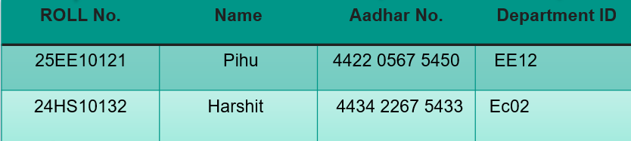
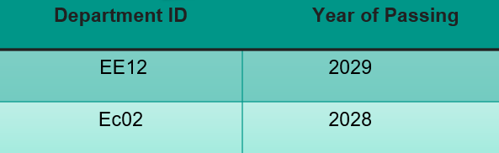
Referential Integrity
Referential Integrity ensures that a foreign key must match an existing primary key ,
Maintains valid relationships between tables
For Ex : In the previous table , Every Department ID in Student Table must exist in Department Table
Pihu → EE12 ✔ (exists in Department table)
Harshit → Ec02 ✔ (exists in Department table)
Referential Integrity keeps data consistent and prevents invalid relationships between tables

Slide 10
Types of relationship in DBMS:
There are 4 types of relationship based on degree:
One to One (1-1)
One record in Table A is linked to only one record in Table B and vice versa
Many to One (N-1)
Many records in Table A relate to one record in Table B
One to Many (1-N)
One record in Table A can be linked to many records in Table B
Many to Many (N-N)
Many records in Table A relate to many records in Table B
Unvisited nodes get UCT = infinity — guaranteeing they are explored before revisiting known nodes.

Slide 11
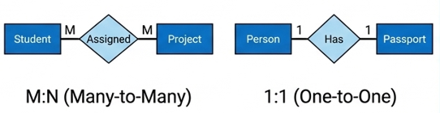
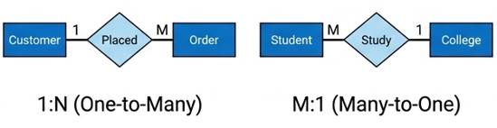
EXAMPLES :

Slide 12
Weak Entity Set & Total Relationship
Weak Entity Set
A Weak Entity Set is an entity that cannot be uniquely identified by its own attributes and depends on another (strong) entity.
Does not have a primary key
Has a partial key (discriminator)
Depends on a Strong Entity
Uses identifying relationship
Total Simulation Reward
Represented by:
Total Relationship
A Total Relationship means every entity must participate in the relationship.
Total relationship ensures data completeness and integrity
Represented by :

Slide 13
Normalization and its types
Normalization is a process in which we organize data to reduce redundancy( duplicacy ) and improve data consistency. It involves dividing a database into two or more tables
Benefits of using Normal Forms:
Reduce duplicate data and wasted storage.
Prevent insert, update, and delete anomalies.
Improve data consistency and integrity.
Make the schema easier to maintain and evolve.
Types of Normalization:
First Normal Form (1NF)
Second Normal Form (2NF)
Third Normal Form (3NF)
Boyce-Codd Normal Form(BCNF)
1 NF
2 NF
3 NF
BCNF

Slide 14

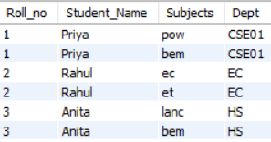
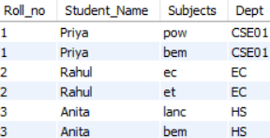
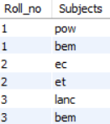

Second Normal Form (2NF): Eliminating Partial Dependency
A relation is in 2 NF if it satisfies the conditions of 1NF and additionally. No partial dependency exists, meaning every non-prime attribute (non-key attribute) must depend on the entire primary key, not just a part of it.
It creates separate table for partial dependency.
First Normal Form (1NF): Eliminating Duplicate Records
A table is in 1 NF if all columns contain atomic values (i.e., indivisible values).
Each attribute is atomic → 1NF satisfied.
→

Slide 15
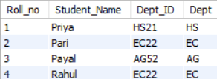

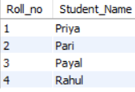



Third Normal Form (3NF): Eliminating Transitive Dependency
A relation is in 3NF if it satisfies 2NF and additionally , there is no transitive dependency for non-prime attributes then table is in the form of 3NF
Boyce-Codd Normal Form (BCNF):
It is stricter version of 3NF where for every non-trivial functional dependency (X → Y), X must be super key (a unique identifier for a record in the table).

Slide 16

SQL (Structured Query Language)
SQL is a standard language for accessing and manipulating databases.
SQL stands for Structured Query Language
SQL lets you access and manipulate databases
SQL became a standard of the American National Standards Institute (ANSI) in 1986, and of the International Organization for Standardization (ISO) in 1987
Uses of SQL:
Insert, update, delete data
Retrieve data (queries)
Manage database structure
“Data is a precious thing and will last longer than the systems themselves.”
.

Slide 17
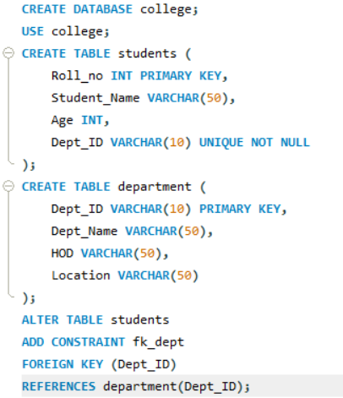
Basic SQL Queries
CREATE DATABASE → creates a new database
USE → selects the database to work on
CREATE TABLE → creates a new table
PRIMARY KEY → uniquely identifies each row
SELECT → retrieves data from table
DISTINCT → removes duplicate values
LIMIT → restricts number of rows returned
WHERE → filters records based on condition
AND/OR/NOT → combines multiple conditions
ORDER BY → sorts data (ASC/DESC)
AVG/SUM/COUNT/MAX/MIN → perform calculations on data
GROUP BY → groups rows with same values
HAVING → filters grouped data
LIKE → searches using patterns (wildcards)
INNER JOIN → shows only matching records
LEFT JOIN → shows all left table records
RIGHT JOIN → shows all right table records
while resources_left():

Slide 18
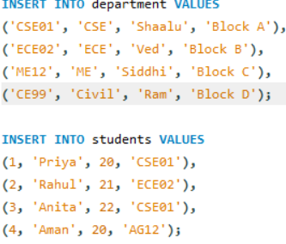
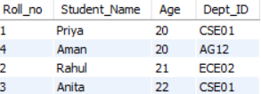
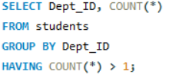

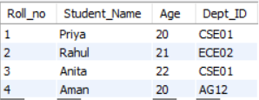
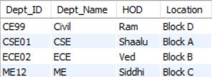



Basic SQL Queries
while resources_left():

Slide 19

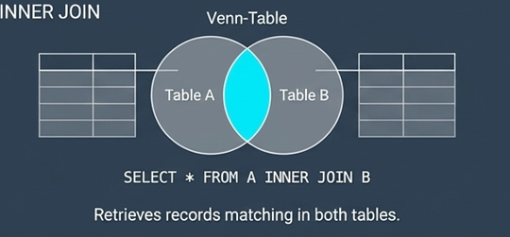

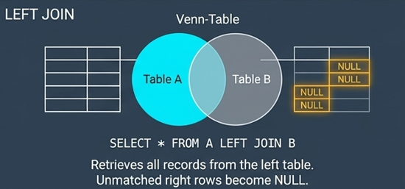

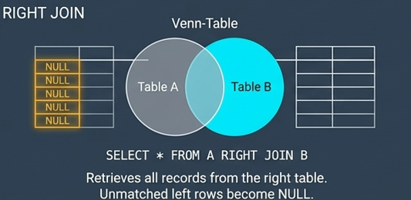
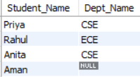
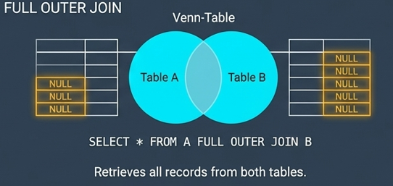
Basic SQL Queries
z
while resources_left():

Slide 20
CONCLUSION
DBMS provides efficient, secure, and structured data management
Overcomes limitations of traditional file systems
ER Diagrams help in designing databases clearly
Normalization reduces redundancy and improves efficiency.
SQL enables easy data retrieval and manipulation.

